Slide 1

Pizza Hut Web Application
Project Members:
1)Ashtaputre Amrutej (56630)
2)Arbind Kumar Yadav (56420)
3)Bachal Swapnil (56640)
4)Bhawar Pranay (56700)
Project Guide:
Mr.Rajiv Kamune

Slide 2
PURPOSE :
To ease the pizza online ordering system which will give easy access to end
user to order and customize pizzas and also to give the control of management
to admin which can add/edit/delete pizzas and their prices. It will help the company to
grow across the region and generate more revenue as well as employment.
Also as a part of academics we have chosen this case study so that
we can apply our learning in practical scenario.

Slide 3
SCOPE :
1.project goals- to develope a online pizza ordering system which helps both admin and end user
to efficeintly use the technology to ease his work.
2.outcomes- It will give priviledge to customer to get pizza delivery at home without going
physically at store and get it at few clicks. In case of admin, it gives priviledges like
taking orders and getting some extra gain through delivery charges and reducing cost of manpower
which requires at store as serving the customers requires more manpower and also
using minimum space to reduce cost of infrastructure
3.tasks- to design and develope the application system which is user friendly
so that anyone can use it easily and deploy it on server and maintain it.
4.costs- by negotiating with client made a deal.

Slide 4
WORK FLOW :
1.requirement analysis-client requirements,what is to be done, which technology is to be used,why this technology,
how to implement that technology, distribution of work among team.
2.database design MySQL.
3.making of backend with the help of java lang and spring boot framework.
4.connecting it to database,
5.backend testing it by using postman
6.developing of frontend with the help of JavaScript lang and react framework
7.connecting it to the backend.
8.testing it after configuration with backend
9.decorated with the help of bootstrap.
10.after final testing deploying it on cloud.
11.presenting it to the client.

Slide 5
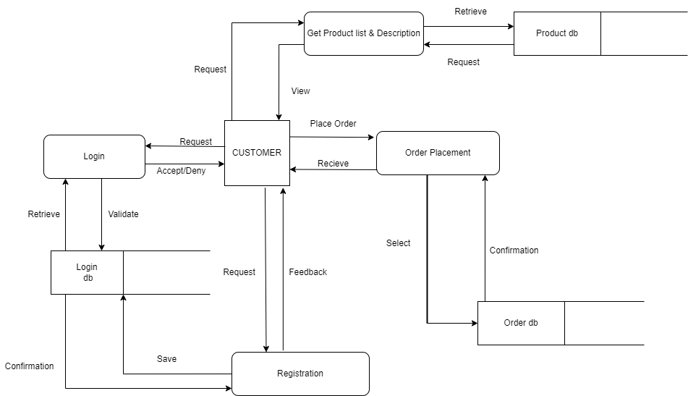
Work Flow - Admin :

Slide 6
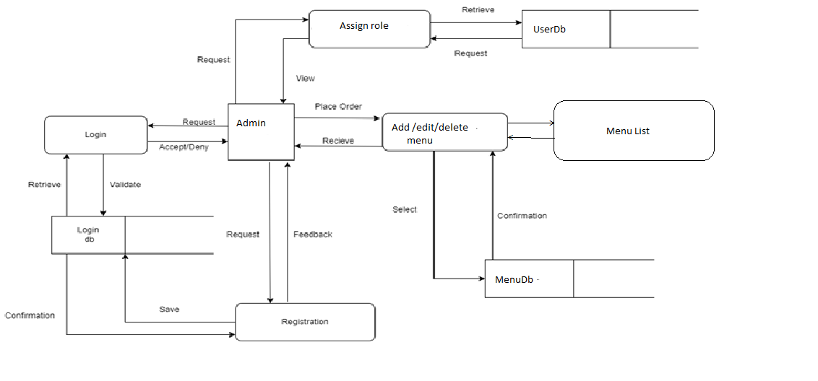
Work Flow – Customer :

